Slide 1
开学典礼&入学教育
Opening Ceremony ＆Entrance education
2016年3月15日
March 15th,2016

Slide 2
本学期学生情况 Students
教务办公室介绍
Educational administration Office
管理规定介绍
Regulations

Slide 3
学生情况介绍（Students）
2015-2016学年第二学期语言进修生情况
来自30多个国家的220多名学生：
4个初级班，7个中级班
2个高级班，2个硕博班
We have more than 220 international students from about 30 countries and areas，in 15 classes.

Slide 4
教务办公室 (Educational administration Office)
教务办公室
请假
Ask for leave
在学证明
Certificate to prove that you are study here
成绩单
The transcript
考勤
Attendance
结业证
Certificate

Slide 5
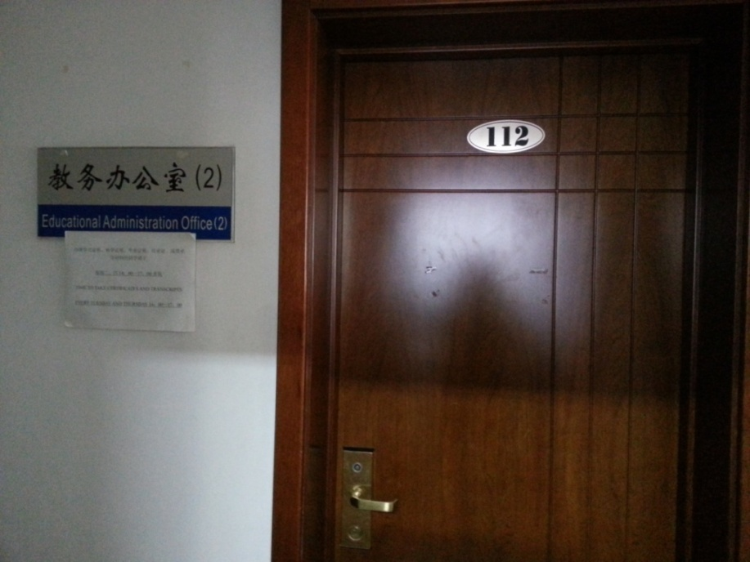
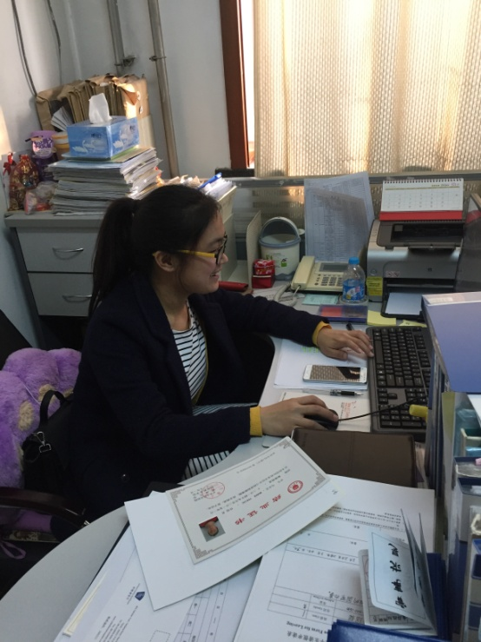
教务办公室介绍
留园C区二层资料室
The Reference Room
教务办公地点：留园A区112
( Office 112 in Liuyuan A District)
Tel：27404699
冯老师 Teacher Feng

Slide 6
管理规定介绍(Regulations)
仔细阅读！
Read it carefully ！
You can find all the information you need in it.

Slide 7
换班Change the class
高班转入低班
低班转入高班
112办公室领取申请表
转出班主任签字同意
转入班主任签字同意
申请表提交112办公室
开课两周内
向班主任提出申请
参加换班考试
同高班转入低班程序
合格
不合格
留在原班

Slide 8
换班Change the class
Class B to class A
Class B to class C
Get an application form in office 112
The head teacher of class B write down “approve”.
The head teacher of class A also write down “approve”.
Give the form back to office 112
In 2 weeks
Tell your head teacher
Take the exam
You can get the form
Pass
Fail
Stay in B

Slide 9
考 勤 Attendance
缺 勤
Absence
迟到、早退15分钟
If you are late or leave early for 15 minutes
旷
课
事
假
病
假
3
缺勤超过40%不颁发结业证
Absence reach to 40％，you can not get the certificate
旷课一次
Be absent for one class

Slide 10
考 勤 Attendance
连续旷课两周（含）以上，或者累计旷课达到本学期计划课时总数1/3（含）以上的学生，学院将对其按照自动退学处理，所交学费不予退还，不予开具转学证明，同时向天津市出入境管理局提请注销其来华签证（居留许可）。对一学期内各门课程全勤的学生，学院将给予表彰和奖励。
If the students’ continuous absence reaches for more than two weeks (including two weeks), or cumulative absence in one semester is over 1/3 (including 1/3), the school will handle the case as automatic withdrawal from the course, Tuition fee will not be refunded, transfer certificate will not be issued. At the same time, the school will submit a cancellation request of visa (residence permit) to the Exit & Entry Administration Bureau under the Public Security Bureau of Tianjin. For students who are full-attendance for each course in one semester, school will grants the rewards.

Slide 11
请 假 Ask for leave
学生到教务办公室填写请假申请表
学生向任课教师提交批准后的请假单
教务办公室签署审批意见（按照考勤规定教务办公室有权批准三天以内的请假）
请假流程：
不履行请假手续按旷课对待
请假不得超过两周

Slide 12
请 假 Ask for leave
Come to office 112 and fill the application form
Students give the approval to your teachers
The teacher will give you the approval (no more than 3 days)
Steps：
The student, who is absent without asking for leave, will be regarded as absenteeism.
The leave can not more than 2 weeks.

Slide 13
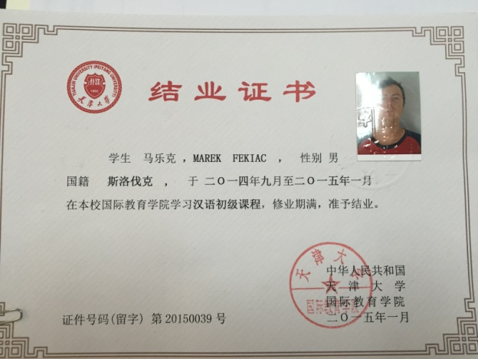
结业(Completion)
期末总评成绩合格的学生，由学院颁发结业证书。
总评成绩不合格者或一学期内缺课（包括病假、事假、旷课）超过40%或缺交作业超过1/3（含）者不颁发结业证，不予开具延长居留许可证明。
出勤10%
作业、测验、语言实践、教学实习20%
平时成绩30%
期中成绩30%
期末成绩40%
总评成绩

Slide 14
结业(Completion)
The students who successfully complete the course will be awarded the Chinese Language Courses completion certificate by the school.
Overall results are not qualified or cumulative absenteeism in one semester is over 40％or undelivered assignment are over 1/3 of the total （including 1/3), no certificate will be granted to the students.
Attendance 10%
Homework 20%
30% out of achievements at ordinary times
30% out of the mid-term exam results
40%out of the final exam results
The overall academic achievements of all courses will be counted as follows:

Slide 15
要求(Requirements)
按时上课
Attend class on time
不迟到
不早退
及时请假
Ask for leave
病假 Sick
事假Private affairs
上课期间不能旅游（If the reason you ask for leave is traveling, you can’t get the approval）
Don’t be late
Don’t leave early

Slide 16
祝你们学习愉快！
Wish you enjoy your study here!

Slide 17
谢谢!Thank you!

